Slide 1
INPEA Webinar Series
Provided in partnership with INPEA, DAST Consulting and CISCO
Finding the Money: Grant Resources, Financing, and Certified Refurbished Gear
May 19, 3-4 p.m. CT / 4-5 p.m. ET

Slide 2
E-Rate
Program
Update
May 2014
Notes:
Filing window closed 3/26/14
Transition Year for Services and Priorities: Eligible services unchanged for now
SLD Releases Early Demand Estimate for funding year 2104
Preliminary demand: $4.868B (combined P1 and P2)
P1: $2.643B and P2: $2.225B
The final FY2014 demand estimate is expected in April
P1 demand will define availability of P2 in 2014
FCC could use a portion of “additional” $2B to bridge the P2 gap
Inflation-based funding cap will be $2.41B

Slide 3
ConnectED is driving E-Rate reform

Slide 4
E-Rate Trends: Growth in Telecom/Internet demand…
…vanishing Equipment/Maintenance funding
Notes:
Bad news
Unelss something changes to erate P1 will be challenged to fund all of P1

Slide 5
Primary Elements of Reform
Amount of funding (i.e. size of the cap)
Making existing funding process more equitable for smaller/rural/non-poverty school systems
Eligible Services List
How should the FCC focus funds on high capacity broadband deployment?
Deliver minimum 100mbps WAN/Internet TO every school
Provide ubiquitous wireless broadband IN every school to teacher/student devices
Should the FCC phase down/out support for traditional voice services?
Timeframe?
Priorities?
Lower Discounts?
Administration of the program
Streamline Process
Cost Effectiveness
Notes:
Public Comment Period
April 6th and reply to comments, April 21st
Cisco is submitting responses
Timeline for E-Rate Modernization
Summer/Fall 2014: Rule changes announced by FCC
Rule changes/etc. start with Funding Year 2015 (Year 18)
Impacts schools RFPs/Form 470s, starting Fall 2014

Slide 6
E-Rate Modernization –
What Could It Mean For Smaller/Rural/Independent K-12?
No one knows with certainty the impact of new rules, but…
FCC Order expected prior to start of 2014-15 school year;
new E-Rate program rules effective 7/1/2015.
“Additional” $2 billion may help bridge gap in 2014 or held back to jumpstart 2015/2016
More focused Eligible Services most relevant to digital learning:
Renewed availability of funding for internal connections across full discount matrix
Restricted/phased out funding for voice services and ancillary telecom services and equipment
Sensitivity to needs of small/rural school systems
Simpler filing process, more liberal program regulations designed to ease burden on applicants

Slide 7
Grant Strategy with Cisco
Jen Messinger
National Commercial Grant Manager

Slide 8
‘GRANTS’ MODEL
Generate Conversations | Work with the Cisco Grants Strategy Team (GST) to explore grants based on existing programmatic needs
Relevance of Technology | Conversations of the relevance of technology to your project and how technology assist in serving more students/teachers and may offer increased services
Awareness of Project/Programs | GST assist in breaking down grant solicitation, offers programmatic ideas & ensures proposal is aligned with scope of grant
Notify Key Stakeholders | Who needs to be involved in your project and at the table? What partners need to be included? Establish your “grants” team.
Transition to Writing the Application | You’ve identified the grant you want to pursue, confirmed project aligns to grant priorities, have included technology for a more innovative project and have gathered key stakeholders. It is time to start writing!
Submission & Implementation | Application is submitted but grants team continues to meet and discuss the plan for implementation of grant program.

Slide 9
Customer Resources
Monthly customer webinars
http://www.publicsectorevent.com/calendar.cfm
https://grantsofficeevents.webex.com/
Funding reports
Grant Calendar
Direct customer support
(prequalification to project implementation)
Customer training
Cisco Capital- Blended opportunity to Finance Match Contribution for Grants

Slide 10
Jen Messinger
Cisco Grants Strategy Team
919.927.1400 E-mail: jennifer.messinger@cisco.com

Slide 11
Cisco Capital Overview Indiana Private Education May 19, 2014
Jim Pantazi
Financial Solutions Manager
Cisco Capital
(636) 735-2561

Slide 12
Cisco Capital
A captive finance source
Wholly owned subsidiary of Cisco Systems, Inc.
Customers get to leverage Cisco financial strength
Over $40B in cash.
Cisco Capital is not subject to market swings like banks and third party’s.
We use the strength of Cisco’s balance sheet to offer financing solutions.
Flexible
No interim rent
Like for like returns
Ability to early terminate and upgrade
Can include non-Cisco assets
Different objectives than a third party lessor
Strategy
Enable Cisco customers to economically acquire, deploy and protect their technology investment with a flexible financial framework.
Notes:
DISCLAIMER (Must appear anywhere this offer is mentioned):
* Applies to Cisco Unified Communications solutions only. Customer eligibility subject to credit approval. Cisco partner must be AT certified and must use Cisco Capital's Progress Payments promotion for customer to qualify. All implementation costs to be included in lease agreement. Maximum deployment period of 120 to 180 days depending on customer type and deal size. Interest charges will begin to accrue after set deployment period and will be billed to the customer monthly until implementation is completed and lease schedule begins. This promotion cannot be combined with any other financing program or promotion. This promotion will expire on July 26, 2008 and can be modified or withdrawn at any time without notice.

Slide 13
Equipment & Financial Life Cycle Management
Acquire
Disposal
Deploy
Upgrade/ Refresh
Maintain

Slide 14
Benefits of Financing for IT Decision Makers
Renew technology to match business requirements
Ability to satisfy your needs now
Remove budgetary constraints
Flexible payment terms e.g. deferred
Maximize available budget
Additional projects can be considered
Protect against technology obsolescence
“Refresh” solution with minimal business impact
Usage without the risks of ownership
Protection from depreciating IT investments
Financing provides IT with flexibility and peace of mind

Slide 15
Benefits of Financing for Finance Decision Makers
Effective cost / benefit management
Avoids significant IT investment spikes
Budget stability / planning
Costs fixed for contract duration
Conserve budgets and preservation of cash
Saves / enables alternative use of budget or liquid assets
Key financial performance indicators improved
Such as return on assets
Potential tax advantages
Finance revenue costs can reduce tax burden
It is the use of equipment that
generates profits, not ownership

Slide 16
Standard Finance Products FMV and $1 Buyout
OPEX (FMV)
Purchase option is at fair market value
Lowest payment – may qualify as an operating lease
Convenient for tech refresh
Available for terms of 2-5 years
CAPEX ($1 BO)
Purchase option is for $1
Low payment, locked in purchase price
Passes depreciation benefit to customer
Available for terms of 2-5 years
FREE Financing on UC Projects
Notes:
16

Slide 17
FY14 Customer Offers – Cisco Capital
Offer | Description | Expiration
3 Month Deferral Financing | Turn a large upfront investment into predictable payments while also offering 3 months free from payments and interest. | July 26, 2014
Cisco Collaboration Breakaway PLUS Financing | Migrate your legacy collaboration solutions with rates as low as 0%. Cisco Collaboration Breakaway Financing only applies to transactions where the customer has qualified under Cisco’s Collaboration Breakaway Program. | July 26, 2014

Slide 18
Cisco Certified Refurbished Equipment
Brad Blough
Remarketing Manager
May 2014

Slide 19
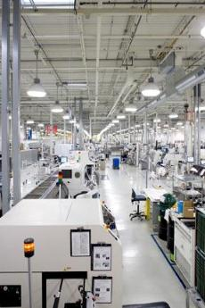
CCRE Program Specifics
In existence since 2001
Cisco’s authorized division of refurbished equipment
Reside under Cisco Capital organization
New and end of sale Cisco products across all technologies – 2,000+ products
Supply available through Cisco supply chain and lease portfolio
Sold through authorized Cisco resellers and distributors or to direct Cisco customers

Slide 20
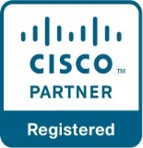
CCRE Value Chain
Product
Sources
Remanufacturing Process
Routes to Market
Stock Rotations
Demo Returns
RMA and Trade-Ins
Manufacturing Overruns
Convention / Olympic Returns
End of Sale Inventory
Cancelled Orders
Lab Equipment
Internal
Lease Returns
* 85% of CCRE on GPL *
Direct Customers
Notes:
Supply: From our authorized distributors, we have access to supply from disty stock rotations and RMAs/trade-ins. RMAs can be damaged units, cancelled orders, returns, open or even close box returns. As part of Cisco Capital, we certainly receive great inventory from our lease returns. And finally, we gain access to product from the Cisco BUs and other groups in the form of manufacturing overruns, cancelled orders, and internal IT refreshes.
Channels: And on the back-end, our products are then sold through our authorized network of resellers (40,000 worldwide). In some cases, customers with a direct buying relationship buy direct from Cisco while the remainder purchase through resellers and/or a combination of resellers and distributors.

Slide 21
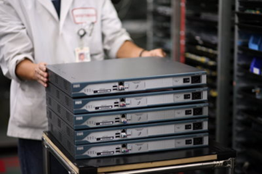
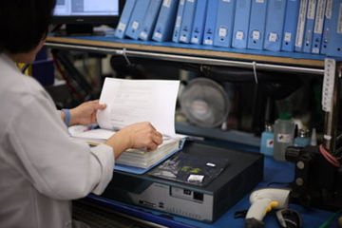
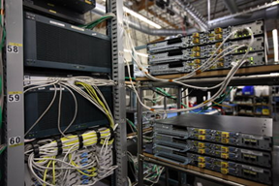
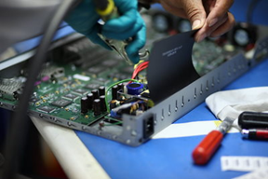
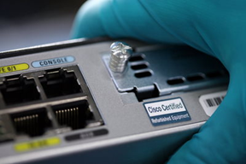
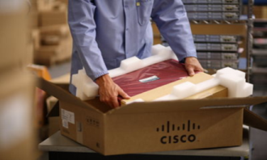
CCRE Remanufacturing Process
INSPECT
UPGRADE
TEST
REPAIR
CLEAN AND RECONDITION
PACKAGE
Notes:
When customers buy Cisco Certified Refurbished Equipment, they are getting the same performance, quality, and peace of mind as when they buy new Cisco equipment. This peace of mind is earned through Cisco’s ISO 9001/14001 certified, comprehensive, and proprietary remanufacturing process and is backed by the same Cisco warranty
and support options as new equipment.
More details if needed:
Inspect: Each unit is physically inspected for damage, serial numbers are verified, and proprietary Cisco data is applied to detect counterfeits. Any items that cannot be repaired are rejected and disposed of through our eco-friendly component recycling process using certified recycling vendors.
Upgrade: The serial number of each unit is checked against the Cisco database to determine if Engineering Change Orders (ECOs) apply. Software and hardware upgrades are performed in compliance with applicable ECOs.
Test: All internal components are physically inspected and all units undergo a rigorous and comprehensive set of diagnostic, functional, and network traffic system tests.
Repair: Units failing any inspection and testing are repaired to Cisco factory specifications, with the faulty components and boards replaced as applicable.
Clean & Recondition: Each unit is cleaned and detailed. Old labels are removed and new labels applied. New fasteners and panels are installed as appropriate. Casings are cleaned, touched up, or repainted as applicable.
Package: Units are carefully wrapped, placed in a new protective shipping box, and sealed in preparation for delivery.

Slide 22
Cisco New and Pre-Owned Comparison
Inventory | Latest generation products All technologies | 2,400+ models across all technologies End-of-Sale products available
Condition | New | Remanufactured and fully tested to Cisco specs Proprietary product hardware and firmware upgrades (ECOs) applied Valid IOS software license included
Warranty | 90 day to limited lifetime | Same
Support | 24 x 7 hardware and software available through Cisco Technical Assistance Center | Same
Pricing | Cisco GPL Applicable discounts and promotions | Discount starting at 65% off GPL No hidden costs
Availability | Full Lead times vary | Dynamic, limited inventory Short lead times, if product in stock
Available Through | Cisco authorized partners and distributors | Same

Slide 23
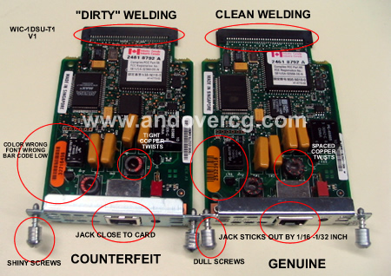
The Gray Market
Products sourced from outside authorized Cisco channels are not guaranteed by Cisco.
These products may have invalid warranties, and definitely have invalid software licenses, no support entitlement, and/or incorrect product configurations.
Cisco is not able to offer support, software updates, hardware replacement or SmartNET coverage on gray market products
Presents a huge business risk to the customer
Tell your customers to verify!
www.cisco.com/go/warranty/
www.cisco.com/go/partnerlocator/

Slide 24
Can We Finance Cisco Pre-Owned Equipment?
Yes, 0% financing available through Cisco Capital through July
Help your Customers:
Lower total cost of ownership
Reduce financial risk
Realize tax savings
Simplify operating budgets
Make the most of their capital budgets
Work with Remarketing Manager or Cisco Capital Channel Account Manager for assistance

Slide 25
Cisco Certified Refurbished Equipment
Just like NEW in quality, warranty and support.
Order today: www.cisco.com/go/refurbished | Questions: refurbquestions@cisco.com

Slide 26
THANK YOU!
Recording and slides will be posted on INPEA website. Have additional questions? Contact:
AMY HERSHMAN – ahershma@cisco.com

