Slide 1
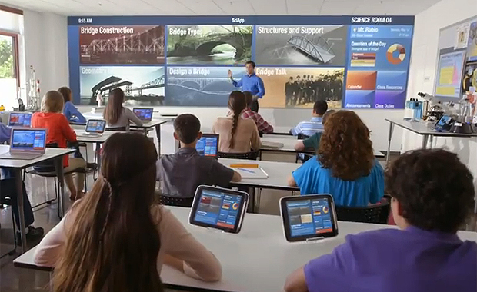
Unified Access: On-Premises versus Cloud Solutions
What works for you
Bruce Alexander, Mobility PSS
brucea@cisco.com
330-523-2470
Education delivery in the classroom is Changing.

Slide 2
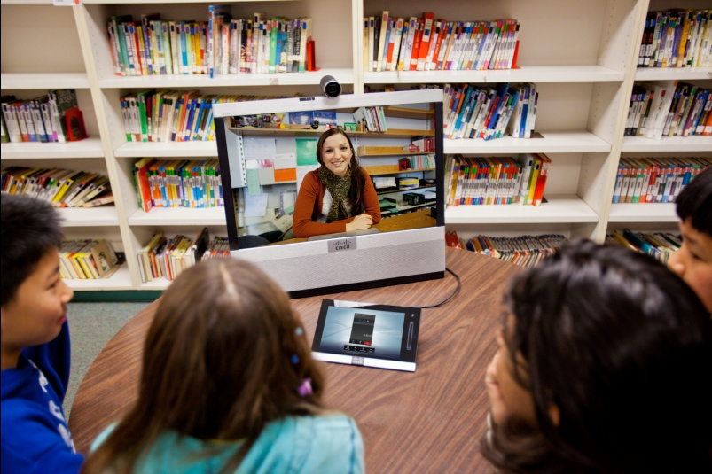


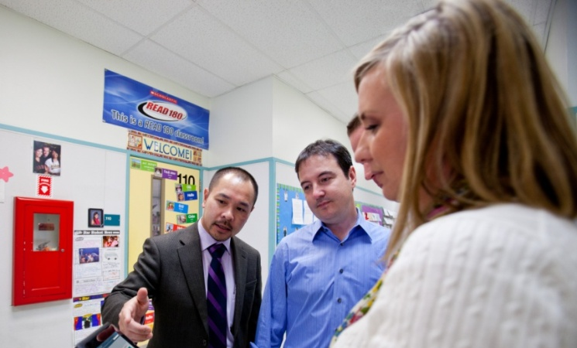


Indiana is considering adopting a testing standard similar to the Common Core State Standards. http://wishtv.com/2014/04/21/new-indiana-education-standards-approved
This means they will likely deliver on-line assessments
Wireless just went from ‘nice to have’ to ‘mission critical’
Meeting Common Core requirements will require a robust network infrastructure, for both broadband and wireless

Slide 3

Key points for future-proofing your Wi-Fi
Scalability
Reliability
Client performance
Ease of Management
BYOD-
  Device Onboarding
  Profiling
Long term Investment protection

Slide 4
Agenda
1
802.11ac architecture, What it means in the classrooms
2
On Prem (Controller) and Cloud Wireless Architectures
3
Mobility Differentiators for schools
4
Cloud vs Controller basics

Slide 5

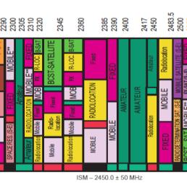
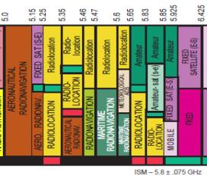
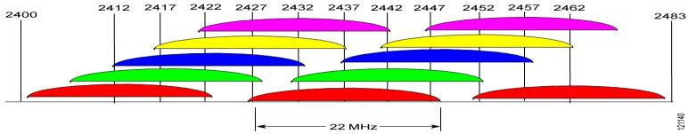
802.11ac – The new ‘Defacto Standard’
High performance and Investment protection

Slide 6
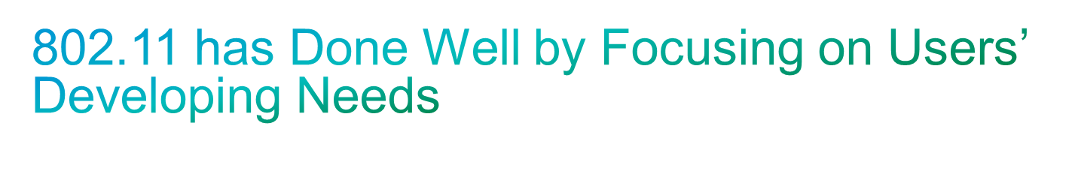
6 yrs
The next generation
11ae
Demanding managed,
reliable & secure
connections anywhere
with high performance
for any application
11aa
5 yrs
11s
11z
11u
11v
11p
11n
11w
11y
3 yrs
11r
11k
11e
Delighted to be
securely connected
2 yrs
11j
11i
11h
11g
Delighted to be connected
11d
11b
11a
11-1997
11-1999
11-2003
11-2012
11-2007
91-93
94
95
96
97
98
99
00
01
02
03
04
05
06
07
08
09
10
11
12
6
Notes:
Discuss lifetime of a wireless AP

Slide 7
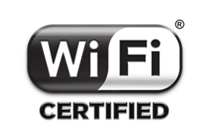
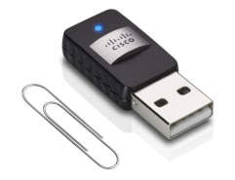
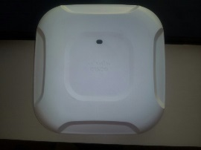
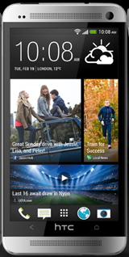
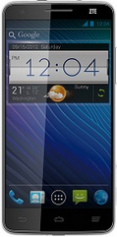



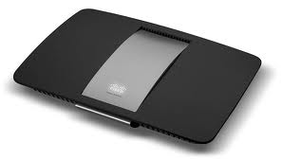

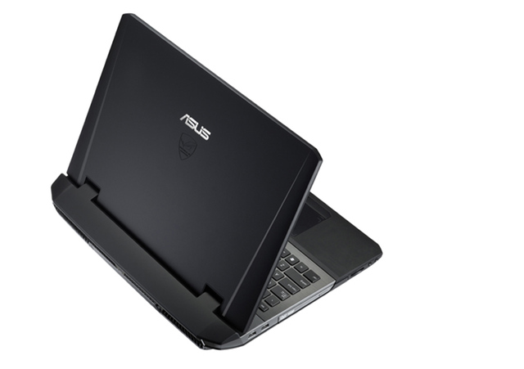

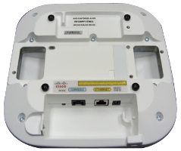
WFA Certification & IEEE
Timeline
IEEE 802.11ac
Ratification
Wave 1
Wave 2
CY 2012 |  |  |  | CY 2013 |  |  |  | CY 2014
Q1 | Q2 | Q3 | Q4 | Q1 | Q2 | Q3 | Q4 | Q1 | Q2 | Q3 | Q4
…
AP3700
Dual-band
802.11ac Wave 1
LinkSys 1x1
AC USB
Client proliferation continues:
Handsets, Tablets, Intel Ultrabooks,
Apple MacBooks
Consumer class devices from Linksys and Netgear
First 802.11ac laptops
802.11ac mobile devices
Cisco 802.11ac Module for Aironet 3600 Series
802.11ac Wave2
Starts to Roll
1H CY15
Samsung S 4
ZTE Grand Memo
HTC One
Notes:
Talk about clients that are available today.. When is Wave 2 coming

Slide 8
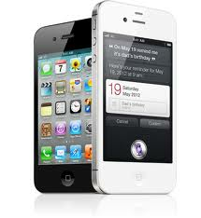



802.11ac Wave 1 Potential Throughput @ 80 MHz
BYOD Continues
802.11ac Performance Table
BW (MHz) | # Spatial Streams | MCS (QAMr5/6) | PHY Rate (Mbps) | MAC Thru-put (Mbps)*
80 | 1 | 64 | 290 | 175
80 | 1 | 64 | 330 | 200
80 | 1 | 256 | 430 | 260
80 | 2 | 64 | 650 | 390
80 | 2 | 256 | 870 | 520
80 | 3 | 64 | 980 | 590
80 | 3 | 256 | 1300 | 780
80 | 4 | 256 | 1700 | 1020
80 | 8 | 256 | 3500 | 2100
1x1
Smartphones from 260 Mbps*
1x1
2x2
Tablets from 520 Mbps*
2x2
3x3
High End Laptops from 780 Mbps*
* Assumes 60% MAC efficiency
Not all Clients will be created equal – early chip drops and quality of components - mileage will vary - Rate & Range, Environment and Deployment will impact coverage and quality
Notes:
Focus on stream definition
Different thruputs of devices
Battery savings,

Slide 9
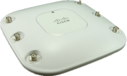
Wave 2
802.11ac - Wave 1 vs Wave 2
Wave 1
With a single stream device, ALL STREAMS have same data- 250 MBPs TOTAL
With a Multi Stream Client- It may still only talk to ONE at a time- Depending on how many streams are available and used by client.
Each stream with different ‘data bits’ of 250MBPS each to a different client.
With a Multi Stream Client- It uses DIFFERENT Streams of data (total of 750+ MBPS for 3 streams)
Single Stream client
High End 3 stream client
Notes:
Wave 2 with single stream /AP as a switch
Wave 2 with 3 stream… AP MAY be a switch/may be a hub, depends on clients and # of streams available.
Bottom line.. Wave2 has SOME benefit.. But may not know until we get there.

Slide 10
802.11ac- What does it mean for the Clients?
In todays world, APs are a HUB- SHARED among users
802.11ac allows faster network access for ALL clients (if some are .11ac)
802.11n AP with 2 802.11ac clients, and 2 802.11n clients.
‘ac’ client #1 packet
‘n’client #2 packet
‘ac’ client #3 packet
‘n’client #4packet
‘ac’ client #1 packet
‘n’client #2 packet
‘ac’ client #3 packet
‘n’client #4packet
‘ac’ client #5 packet
802.11ac AP with 2 802.11ac clients, and 2 802.11n clients.
Bottom line-
Running 802.11ac will improve overall performance per AP cell, AND allow more users per AP!
In a 50% 802.11ac client environment, a minimum of 33% improvement of performance is realized. As ac clients increase, so does performance.

Slide 11
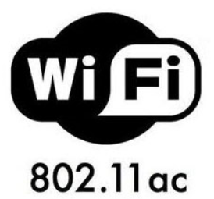

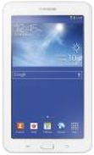

802.11ac- Battery Life
The largest battery consuming portion of a Smart phone?
  The Transmitter!
The 2ed largest battery consuming portion of a table?
  Yep – The Transmitter!
802.11ac allows faster packet transmission- reducing transmitter time
  Average 50% less battery usage if running 802.11ac vs. 802.11n AP.
  See http://www.youtube.com/watch?v=03rE2L_6pG0
Results:
802.11ac APs will allow 802.11ac client batteries to last up to 50% longer!

Slide 12
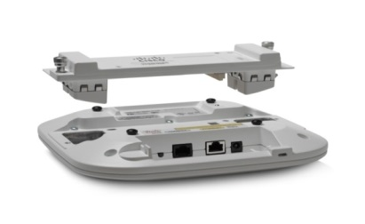
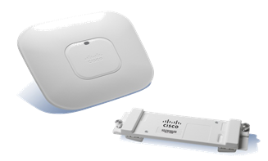
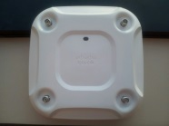
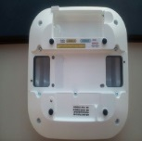
Is 802.11ac being deployed today?- YES!
Cisco – over ½ million 802.11ac enabled APs shipped!
Per ABI Research-
  Mid 2014 50% all clients shipping will be 802.11ac
  By end of 2014 70% of all clients = 802.11ac
  Just in time for the Christmas ‘refresh’
Expectations?:
802.11ac is being deployed, and 802.11ac clients will be a major portion of classroom clients in next 2-3 years.

Slide 13

802.11ac- What does it mean for the classroom?
Better performance = higher level of performance for Classroom applications like video and collaboration
Better battery life = less disruptions for Charging
Higher density of users possible (full classroom of students actively engaging over wireless)
What is means:
802.11ac helps to enable Mission Critical Wireless

Slide 14
  Density if APs in K12-
  Questions that can help determine 1 or 2 classrooms per AP design
  Q. How many clients can an AP support???
  It depends!!
    What is meant by ‘support’?
      ACTIVE Session or just associated?
    What type of data is being handled?
      Internet/e-mail, or video/video-confrencing?
    What type of AP is used. # of processors, memory, 802.11a,ac,
      A lower quality AP will require one in EVERY classroom
  Q. What is the range of the AP?
  A. In years past, wireless was tested and rated by rate vs range…
  Today it is about throughput and density!
  Q. How does 802.11ac differ from 802.11n?
  A. In terms of Rate/range- minimally in a K-12!

Slide 15
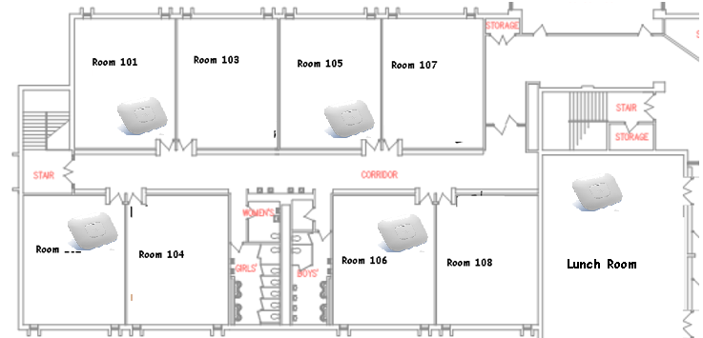
AP Deployment in K-12
Varies in many districts.
  Typical approach has been----
  K-5 802.11n (1 every 1 or 2 classrooms)
  Middle school- 802.11ac- 1 per 2 classrooms
  High School- 802.11ac- 1 per classroom
Some areas require multiple APs for density
Placed near wall to support 2 classrooms

Slide 16
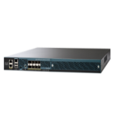


The Most Architectural Options
Deployment Flexibility
802.11ac
802.11ac
Dashboard
WAN
WAN
Intranet
Autonomous AP | Cloud Managed | Remotes APs | Centralized | Converged Access
Static installations Point-to-Point / Work Group Bridge Stand alone Access Points | Network-as-a-Service Common LAN & WLAN OS LAN & WLAN consistency No Controller Distributed enterprise | Network-as-a-Platform Data Center hosted Controller Branch deploy | Network-as-a-Platform Premise-based Controller Controller at every location Centralized Controllers | Network-as-a-Platform LAN & WLAN consistency High performance Campus & branch Wired and Wireless mixing
Notes:
Focus on 3 primary architectures- don’t spend much time here

Slide 17

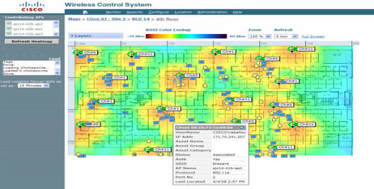

Traditional: All Traffic To Controllers
CAPWAP (formerly LWAPP)
WLAN Controller
To Destination
Switch/Routed
Network
Access Points
Wireless LAN Mgmt Console
Notes:
Talk about possibility of overwhelming the Controller with a large numbe ros 802.11ac APs and Clients

Slide 18

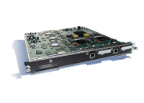




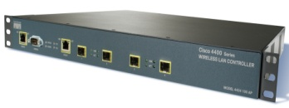


FlexConnect (H-REAP)
Only Control Traffic Flows To Controller – Data Traffic Dropped Locally
Controller
Outdoor Mesh
Identity Services Engine (ISE)
Central Office
PRIME Infrastructure
WAN
Mobility Services Engine (MSE)
To Destination
Controller
Flexconnect APs
To Destination
Flexconnect AP
Remote Office
Branch Office
Regional Office
Notes:
Floex can be used teo offload some data. But is has limitations too, like AP group size.

Slide 19




Converged Access Deployment Mode –
ISE
Prime
Pushing Controller Functionality Out To The Switch Port
Drops all traffic local at switch
Mobility Controller
Controller
To Destination
Capwap Tunnel
To Destination
Standard Ethernet, No Tunnels
Guest Tunnel from Switch to DMZ Controller
Mobility Agent
Older Switch
New Technology Switch
Access
Points
LARGE CAMPUS

Slide 20
Cloud Managed, Secure and Reliable
Scalable
  Unlimited throughput, no bottlenecks
  Add devices or sites in minutes
  Network-wide monitoring and management tools
  Self-provisioning for rapid deployment
  Integrated wireless, LAN, and WAN management
Reliable
  Highly available cloud with multiple datacenters
  Seamless over-the-web firmware upgrades
  Network functions even if connection to cloud is interrupted
  99.99% uptime SLA
Secure
  No user traffic passes through cloud
  Fully HIPAA / PCI compliant (level 1 certified)
  3rd party security audits, daily penetration test
Cloud Management
1 Kb
Management traffic (Secure tunnel)
To Destination
Data Traffic
Local Switch
AP
Notes:
Cloud has no controller, so no bottleneck

Slide 21

Controller and Cloud-Managed Networking Portfolio Optimized for Unique Needs
Network based (Controller) Management
Cloud Management
3rd Party MDM Integration
MDM
WLAN Controllers
Switches
with integrated controller
Dashboard
Switching
Switches
Access Points
APs
Routing, Security, WAAS
Security (UTM)
Ease of Use
Wide Flexibility
Simplified Management & Deployment
RF Excellence & Location Services

Slide 22
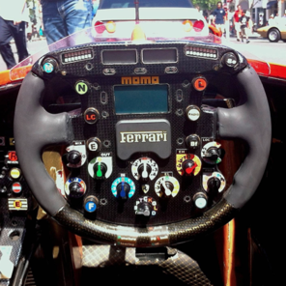



The Ferrari Comparison…
Controller Based…
Cloud Managed …
Innovates to get more output from the engine,
Requires more knobs and buttons to deliver the additional performance…
Innovates to simplify the driving experience,
Makes the baseline power of a Ferrari available to any level of driver…

Slide 23
The Ferrari Comparison…
Controller Based
Cloud Managed
Innovates to improve performance and programmability
Innovation via customized hardware
Innovates to simplify operations and management…
Innovation via cloud software

Slide 24
Cisco Enterprise and Cloud Managed
Ownership vs. Subscription differences
  Ownership – is the traditional consumption model for network infrastructure for the majority of the market at this time. For many businesses the only methods they can purchase network components with is either outright purchase or a lease with ownership transfer at lease end. If “Ownership” is the preferred consumption model then go with Enterprise Unified Access.
  Term Licensing/Subscription – is a new and increasingly popular consumption model for network infrastructure in which the hardware is purchased and owned outright in the traditional sense, but the software that runs and manages the hardware is sourced via the Cloud as a recurring subscription. If the subscription is not maintained the hardware becomes inoperable. If “Subscription” is the preferred consumption model then go with Cloud Managed Unified Access.
Notes:
Onsite or Private Cloud –the majority of the market at this time.
Centralizing control and management of infrastructure in Data Centers, controlled entirely by IT, is the only acceptable method of operation.
“Private Cloud” is the preferred implementation model for controlling and managing network infrastructure then go with Enterprise Networking Mobility Solution
Public Cloud – is an increasingly popular implementation
Control and management of the network infrastructure happens via the Public Cloud. must be comfortable with abstracting control and management to the Public Cloud. network Data traffic is not going to the cloud (unless configured to do so) which means full network operation is still happening if the Internet connection goes away.
Only config changes and up-to-date statistics will be affected.
If “Public Cloud” is the preferred implementation model for controlling and managing network infrastructure then go with Cloud Networking Mobility Solution.
Cisco Enterprise Unified Access has been optimized for Enterprise customers who view the network as an innovation platform and demand granular control and deployment flexibility.
Cloud Managed Unified Access has been optimized for Enterprise customers who view the network more as a service and favor simplified deployment and management above all else.

Slide 25
Which Mobility Solution should you position?
Enterprise Networking
or
Cloud Networking …
Start
Do you prefer ownership or a subscription consumption model for network infrastructure?
Ownership
Leased or Doesn’t Matter
What is the bandwidth of your technical team who will manage the wireless network?
Lean IT
Wide
Where do you prefer the configuration and statistics be stored for your network infrastructure?
Onsite
Cloud Networking Mobility Solution
Cloud
Controller Solution
Doesn’t Matter

Slide 26


On Prem and Cloud Managed Differentiation
Controller Based
Cloud Managed
HW and SW both owned by the customer
Granular control and highly customizable
Portfolio that can say yes to any use case
Optimized for scale and high performance
Extensibility though APIs and SDKs
Advanced troubleshooting tools
Every certification imaginable
HW owned by customer, SW is not
Simplified Deployment and Management
Targeted portfolio for mid-market use cases
Subscription based feature delivery
Cloud based out-of-band management
Integrated Mobile Device Management
High velocity feature development
versatile
Network as a Platform
Network as a Service

Slide 27

Classrooms are changing.
We have to keep up
What you will have:
BYOD
2-4 devices per student
ALL wireless
Online testing
Video instruction
Collaboration
Remote guest instructors
What you will need:
Ethernet like reliability- Mission Critical
Ease of access- so easy a ‘caveman can do it’
Wi-Fi everywhere students will be
Policy enforcement- Right user to right resource
Wireless is now THE Network!

