Slide 1
Indiana’s Education Tornado
INPEA
June 7, 2018

Slide 2
Agenda
An Update on all of the Changes
Impact on Non-Public Schools
Getting Prepared
Discussion on Creative Solutions
-What’s being explored?
-What can we do together?
-How can INPEA help?

Slide 3
Changes
Assessment
Accountability
Curriculum & Trainings
Graduation Pathways
School Safety

Slide 4
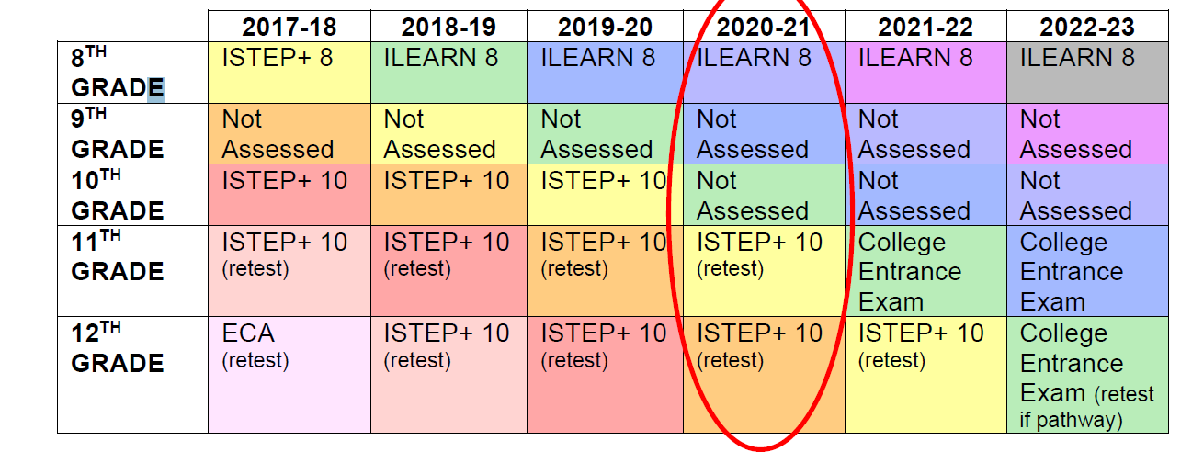
Assessment

Slide 5
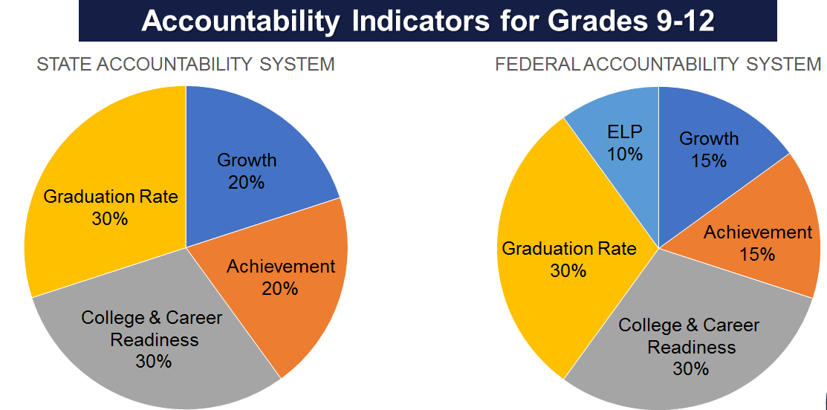
Accountability

Slide 6
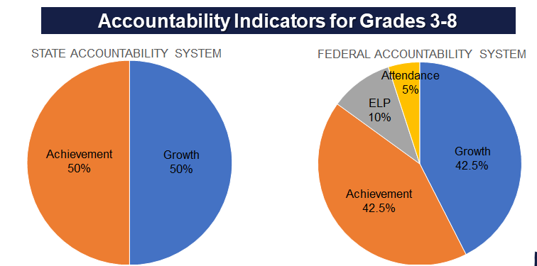
Accountability

Slide 7
Curriculum & Trainings
High Schools: Addition of Electives in Ethnic Studies and Indiana Studies
Heat Preparedness (Coaches) HB1024
Human Trafficking HB1230
Safety Training HB1230 (added)
Dyslexia SB217 (Public schools only)
Teen Suicide Prevention Training (HEA 1430)
Child Abuse and Child Sexual Abuse (SEA 355)
Teacher Training
Student Education

Slide 8
Graduation Pathways

Slide 9
The Three Tiers
Diploma
Employability Skills
Post Secondary Ready Competencies

Slide 10
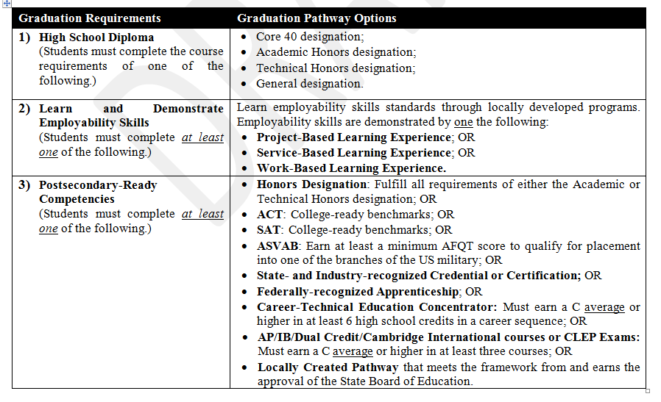

Slide 11
Diplomas
Single Diploma with Designations
-Core 40 designation
-Academic Honors designation
-Technical Honors designation
-General designation

Slide 12
Elementary – Middle School

Slide 13
Employability Skills

Slide 14
Employability Skills

Slide 15
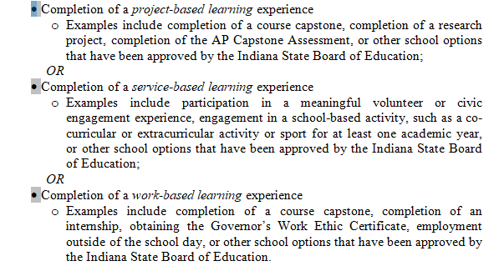
Employability Skills Options

Slide 16
Service Based Learning

Slide 17
Employability Skills Completion Product

Slide 18
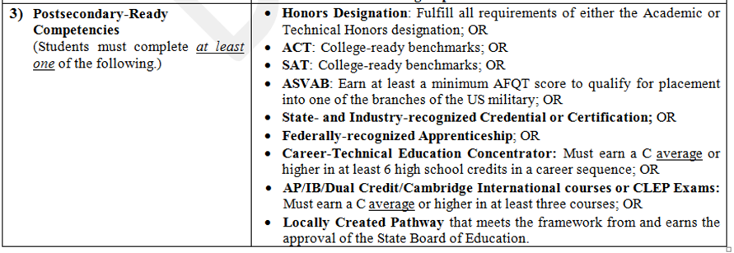
Post Secondary Ready Competencies

Slide 19
Locally Developed Pathways

Slide 20
Discussion/Networking (Employability Skills)
What ways are you considering meeting the employability skills requirements in your school?
How and who will track this?
Who might you partner with ?

Slide 21
Discussion/Networking Post Secondary Readiness
What concerns do you have regarding some students meeting one of the PSRC?
Have you considered using Locally Developed Pathways?
What kind of pathways are you considering?
Who might you be partnering with?

Slide 22
Discussion Summary
Table Leaders share the “take aways” from your discussion.
Employability skills
CTE Opportunities
Locally Developed Pathways

Slide 23
Moving Forward
What are some next steps we should consider?

Slide 24
Continuing the Conversation
INPEA Pathways Private Facebook Page
SBOE Website(more info)
https://www.in.gov/sboe/

Slide 25
INPEC 2018

Slide 26
Stay Informed
INPEA
www.inpea.org
John Elcesser
jelcesser@inpea.org
@inpeajohn
@inpea_voice
Like us FaceBook
INPEA Updates

