Slide 1
Graduation Pathways A Web Conversation
High Schools
April 15th 2019
Elementary Schools
April 16th, 2019

Slide 2
Our Agenda & Goals
Overview
Discussion Groups with Focus Questions
Reporting Back
Best Practices
Challenges
Need to know more
What can we learn from each other?

Slide 3
Graduation Requirements
Before 2023
Meet Diploma Requirements
Pass the GQE (ISTEP+ 10)
Not passing the GQE (ISTEP+ 10), but receiving a waiver
2023 (Grad Pathways or before by request)
Successfully completing the Graduation Pathway requirements (3 buckets)
Unsuccessfully completing the Postsecondary-Ready Competency requirement, but receiving a waiver

Slide 4
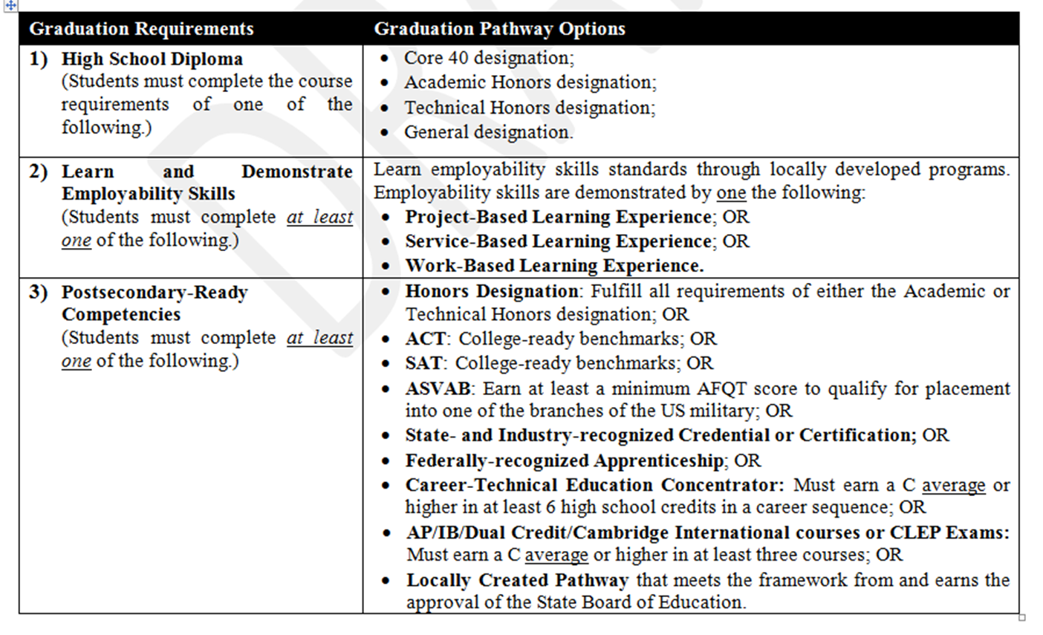
Overview

Slide 5
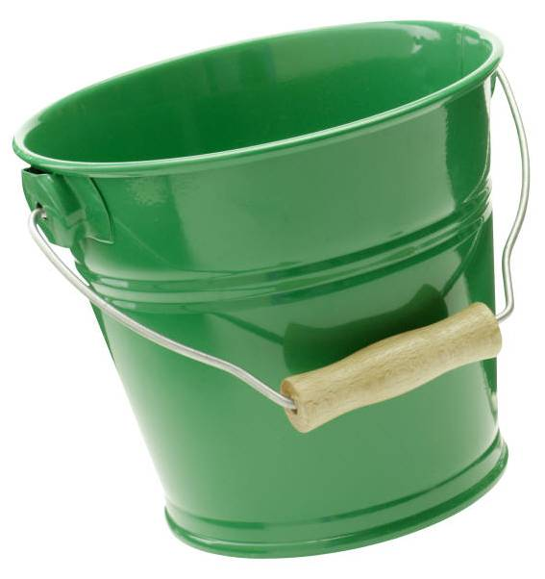
Bucket #1
Meeting the diploma requirements for one of the four diploma designations

Slide 6
Bucket #2
Employability Skills – Being able to demonstrate essential employability (soft) skills needed to be successful in today’s work environment
Mindsets, self management skills, learning strategies, social skills, workplace skills.

Slide 7
Bucket #2 Employability Skills
Complete one of the following
Project Based Experience
Service Based Experience
Work Based Experience
Student Work Product Required
Design Principles Included
Employability Skills Benchmarks
https://www.in.gov/dwd/files/IN_Employability_Skills.pdf

Slide 8
Postsecondary-Ready Competencies – Bucket #3 Students must complete at least one of the following
1. Honors Diploma
2. ACT or SAT
4. ASVAB
5. Industry Cert
Apprenticeship
7. CTE Concentrator
8. AP/IB/Dual Credit/Cambridge Int./CLEP
9. Locally Created Pathways

Slide 10
Career Exploration
Career Exploration skills consists of learning how to identify and analyze various career options in terms of what education, training, experience, and competencies are required for success. Exploration includes learning in workplace environments or directly in workplaces to discover and experience what it may be like to work in different occupations. It also involves learning how to evaluate how well a career matches or fits one’s own interests, skills, strengths, and work values.

Slide 11
Career Planning
Career and Academic Planning equips students and their families with the tools necessary to make more informed choices about secondary and postsecondary education and training as it leads to careers. Students develop a Graduation Plan as both a learning process and a planning document for academic, career & technical education, dual credit coursework, workplace learning and activities aligned to career goals.

Slide 12
Discussion Groups
Process (25-30 minutes): Watch Chat!
Quick Round Robin Introductions
Name, School, Position, Birth Month & Date (not year☺)
Leader and Recorder
Discussion Questions
Taking Notes
Reporting Back
Best Practices
Challenges
Need to know more

Slide 13
Discussion Questions
What is your overall understanding of graduation pathways?
What is school doing (hope to do) around career awareness and exploration in light of Grad Pathways? In what grades?
Has your school partnered with employers or community organization in your career exploration activities?
Has your school considered job shadowing, mentoring, career fairs or other creative ways of career exploration?
Have you had any interaction with “your” high schools regarding grad pathways?
What do you need more information on?

Slide 14
Reporting Back
Best Practice Takeaways?
-What were some of the best implementation ideas that you learned about in your discussion?
What were some of the consistent challenges shared in your discussion?
What do you need more info on?
Email your notes to hharmon@inpea.org

Slide 15
INPAC Pre-Conference Implementing Grad Pathways
September 23rd 8:30 AM
Renaissance Hotel, Carmel IN
“Never Stand Still: Shaping the Future”

Slide 16
Resources
DOE Resources
https://www.doe.in.gov/graduation-pathways
State Board Guidance
https://www.in.gov/sboe/files/Graduation%20Pathways%20-%20Guidance%20final.v8.pdf
Middle School Toolkit
https://www.doe.in.gov/sites/default/files/graduation-pathways/middle-school-toolkit.pdf

