Slide 1
Graduation Pathways A Web Conversation
High Schools
April 15th 2019
Elementary Schools
April 16th, 2019

Slide 2
Our Agenda & Goals
Quick overview
Discussion Groups with Focus Questions
Reporting Back
Best Practices
Challenges
Need to know more
What can we learn from each other?

Slide 3
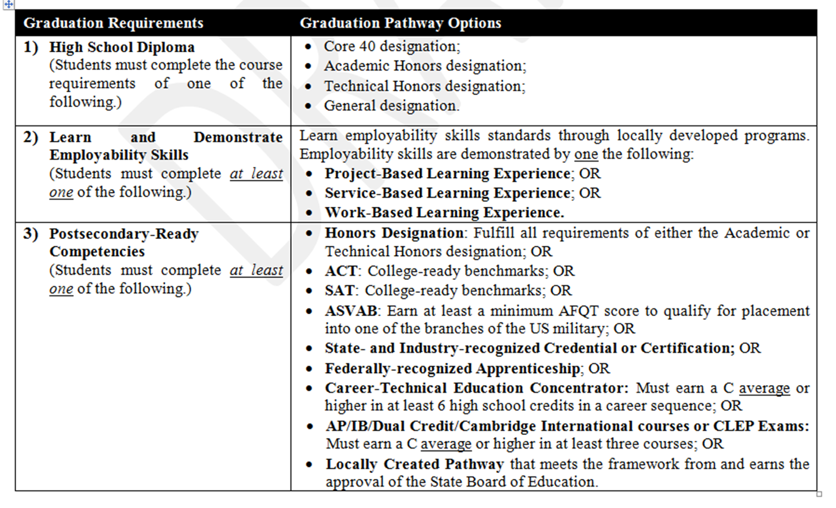
Overview

Slide 4
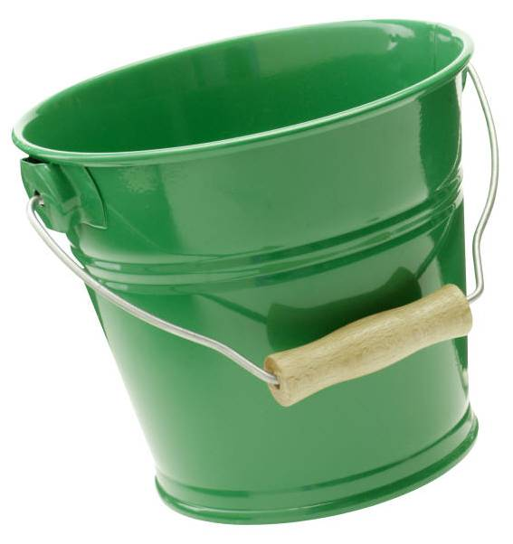
Digging Deeper
Bucket #1
Bucket #2
Bucket #3

Slide 5
Bucket #1 Diploma Options
Meeting requirements for one of the four Diploma Designations
Current legislation would allow the substitution of CTE courses for requirements on Academic Honors Diploma (as long as they were of equal rigor)

Slide 6
Bucket #2 Employability Skills
Complete one of the following
Project Based Experience
Service Based Experience
Work Based Experience
Student Work Product Required
Design Principles Included
Benchmarks
https://www.in.gov/dwd/files/IN_Employability_Skills.pdf

Slide 7
Service Learning Design Principles
Design Principles
1. Meaningful Service
2. Link to Curriculum
3. Reflection
4. Diversity
5. Youth Voice
6. Partnerships
7. Progress Monitoring
8. Duration and Intensity

Slide 8
Postsecondary-Ready Competencies – Bucket #3 Students must complete at least one of the following
1. Honors Diploma
2. ACT or SAT Benchmark
4. ASVAB
5. Industry Cert
6.Apprenticeship
7. CTE Concentrator
8. AP/IB/Dual Credit/Cambridge Int./CLEP
9. Locally Created Pathways

Slide 9
Bucket #3 PSRC Non-Traditional Options
ASVAB – Minimum of 31
Industry Certification from DWD approved list
Federally recognized Apprenticeships
CTE Concentrator Must earn a C average in at least two non-duplicative advanced courses (courses beyond an introductory course) within a particular program or program of study.

Slide 10
Bucket #3 PSRC Non-Traditional Options
AP/IB/Dual Credit/Cambridge International/CLEP
C or higher in three courses (1 or 3 must be in a core content area)
Locally Created Pathway (approved by SBOE)
Developed in Collaboration or Partnership
Competency and Currency
Continuous Improvement
Measuring Outcomes
Improving the Process

Slide 11
Discussion Groups
Process (25-30 minutes): Watch Chat!
Quick Round Robin Introductions
Name, School, Position, Birth Month & Date (not year☺)
Leader and Recorder
Discussion Questions
Taking Notes
Reporting Back
Best Practices
Challenges
Need to know more

Slide 12
HS Discussion Questions
What do you feel your school has done well in terms of grad pathways implementation?
How will your school approach Bucket #2 – employability skills? Are you familiar with the State criteria for Bucket #2?
What is your counselor(s) doing in terms of providing guidance around the broader vision of grad pathways?
How do they/will they track pathways for students?
How will your school approach Bucket #3? Will your school be offering work force options (i.e. CTE, credentials and certificates, apprenticeships)? How?
Is anyone using ASVAB, Cambridge International or CLEP exams?
What are the biggest challenges that you face with
Grad Pathways?
What do you need to know more about?

Slide 13
Reporting Back
Best Practice Takeaways?
-What were some of the best implementation ideas that you learned about in your discussion?
What were some of the consistent challenges shared in your discussion?
What do you need more info on?
Email your notes to hharmon@inpea.org

Slide 14
INPAC Pre-Conference Implementing Grad Pathways
September 23rd 8:30 AM
Renaissance Hotel, Carmel IN
“Never Stand Still: Shaping the Future”

Slide 15
Resources
DOE Resources
https://www.doe.in.gov/graduation-pathways
State Board Guidance
https://www.in.gov/sboe/files/Graduation%20Pathways%20-%20Guidance%20final.v8.pdf

