Slide 1
Teaching
Grammar & Mechanics through Writing
INPEC 2021
October 5, 2021
Notes:
Welcome
Introduction of myself

Slide 2
Grammar
USAGE
It is the correct USAGE of our language - spoken or written
Verb tense; plurals; sentence formation
Mechanics
PUNCTUATION and CAPITALIZATION
We don’t speak using punctuation and capitalization, so this tends to be more difficult for students to learn and apply

Slide 3
CUPS
Capitalization
Usage
Punctuation
Spelling
Aimee Buckner, 2005

Slide 4
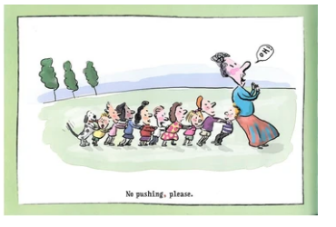
Eats, Shoots, and Leaves
by Lynne Truss
No pushing, please.
No pushing please.

Slide 5
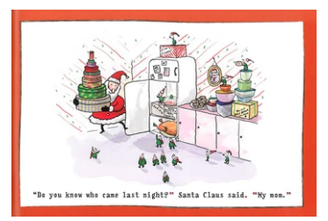
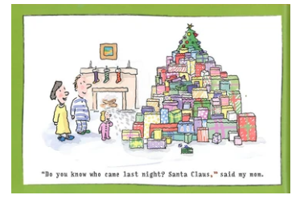
Twenty Odd Ducks
by Lynne Truss
“Do you know who came last night?” Santa Claus said. “My mom.”
“Do you know who came last night? Santa Claus,” said my mom.

Slide 6
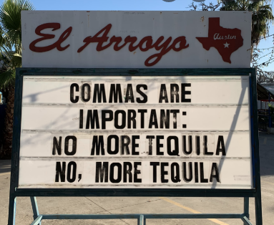
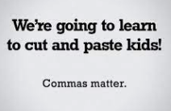

Slide 7
“In the end, the whole purpose of grammar and convention instruction is to elevate writing.”
Jeff Anderson

Slide 8
Research
“As far back as 1936, the NCTE has found that the formal teaching of grammar and mechanics had little effect on students’ writing and, in fact, had deleterious effects when it displaced writing time”
Jeff Anderson
“Marking every error does about as much good as yelling down a hole”
Nancy Atwell
“Telling kids about grammar and mechanics translates to students as Peanuts-teacher talk - the equivalent of blah, blah, blah.”
Jeff Anderson
“The conclusion can be stated in strong and unqualified terms: the teaching of formal grammar has a negligible or, because it usually displaced some instruction and practice in actual composition, even a harmful effect on the improvement of writing”
Braddock, Lloyd-Jones, & Schoer

Slide 9
What do we do?
​​
Explicitly teach grammar and mechanics through writing and in context of writing
We make sure students get PLENTY of time to write and try out all these skills
Teach units focused on punctuation or on using grammar appropriately
Throw out the worksheets. Insteach, have students write their own compound sentences; create their own sentences with contractions

Slide 10
Why should we ‘switch’?
It is a unit where students get to choose topic AND the genre. Students need choice – it provides motivation, interest – it is what helps them get better. Here’s a way to teach something they need, and to let them choose topic AND genre.
Weeks zooming in on a specific skill, with lots of mentor sentences, lots of time for modeling, lots of time for practice and application.
They are learning grammar and/or mechanics AND they are writing.
We have to give kids TIME to use these skills in writing. They have to practice it how we are expecting them to use it, not in isolation or on a worksheet. Our goal is application in their writing, therefore we have to teach it and practice these skills in their writing.

Slide 11
NOW WHAT?
1. Let’s plan a unit together!
2. Brainstorm different grammar and mechanic unit ‘ideas’ for your grade level
3. Explore mentor texts to find some for your grade level unit ‘ideas’
4. Brainstorm quick grammar and mechanics practice and assessment activities (what can we do instead of traditional DOL?)

Slide 12
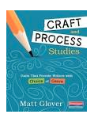
Planning a Unit
Matt Glover - Craft and Process Studies
Jeff Anderson - Patterns of Power
1. What are we teaching?
2. How many lessons are we planning to teach?
3. What specific skills are important for this topic? What order do we want to teach them?
4. What mentor texts/sentences will we use as support?
Unit Plan

Slide 13
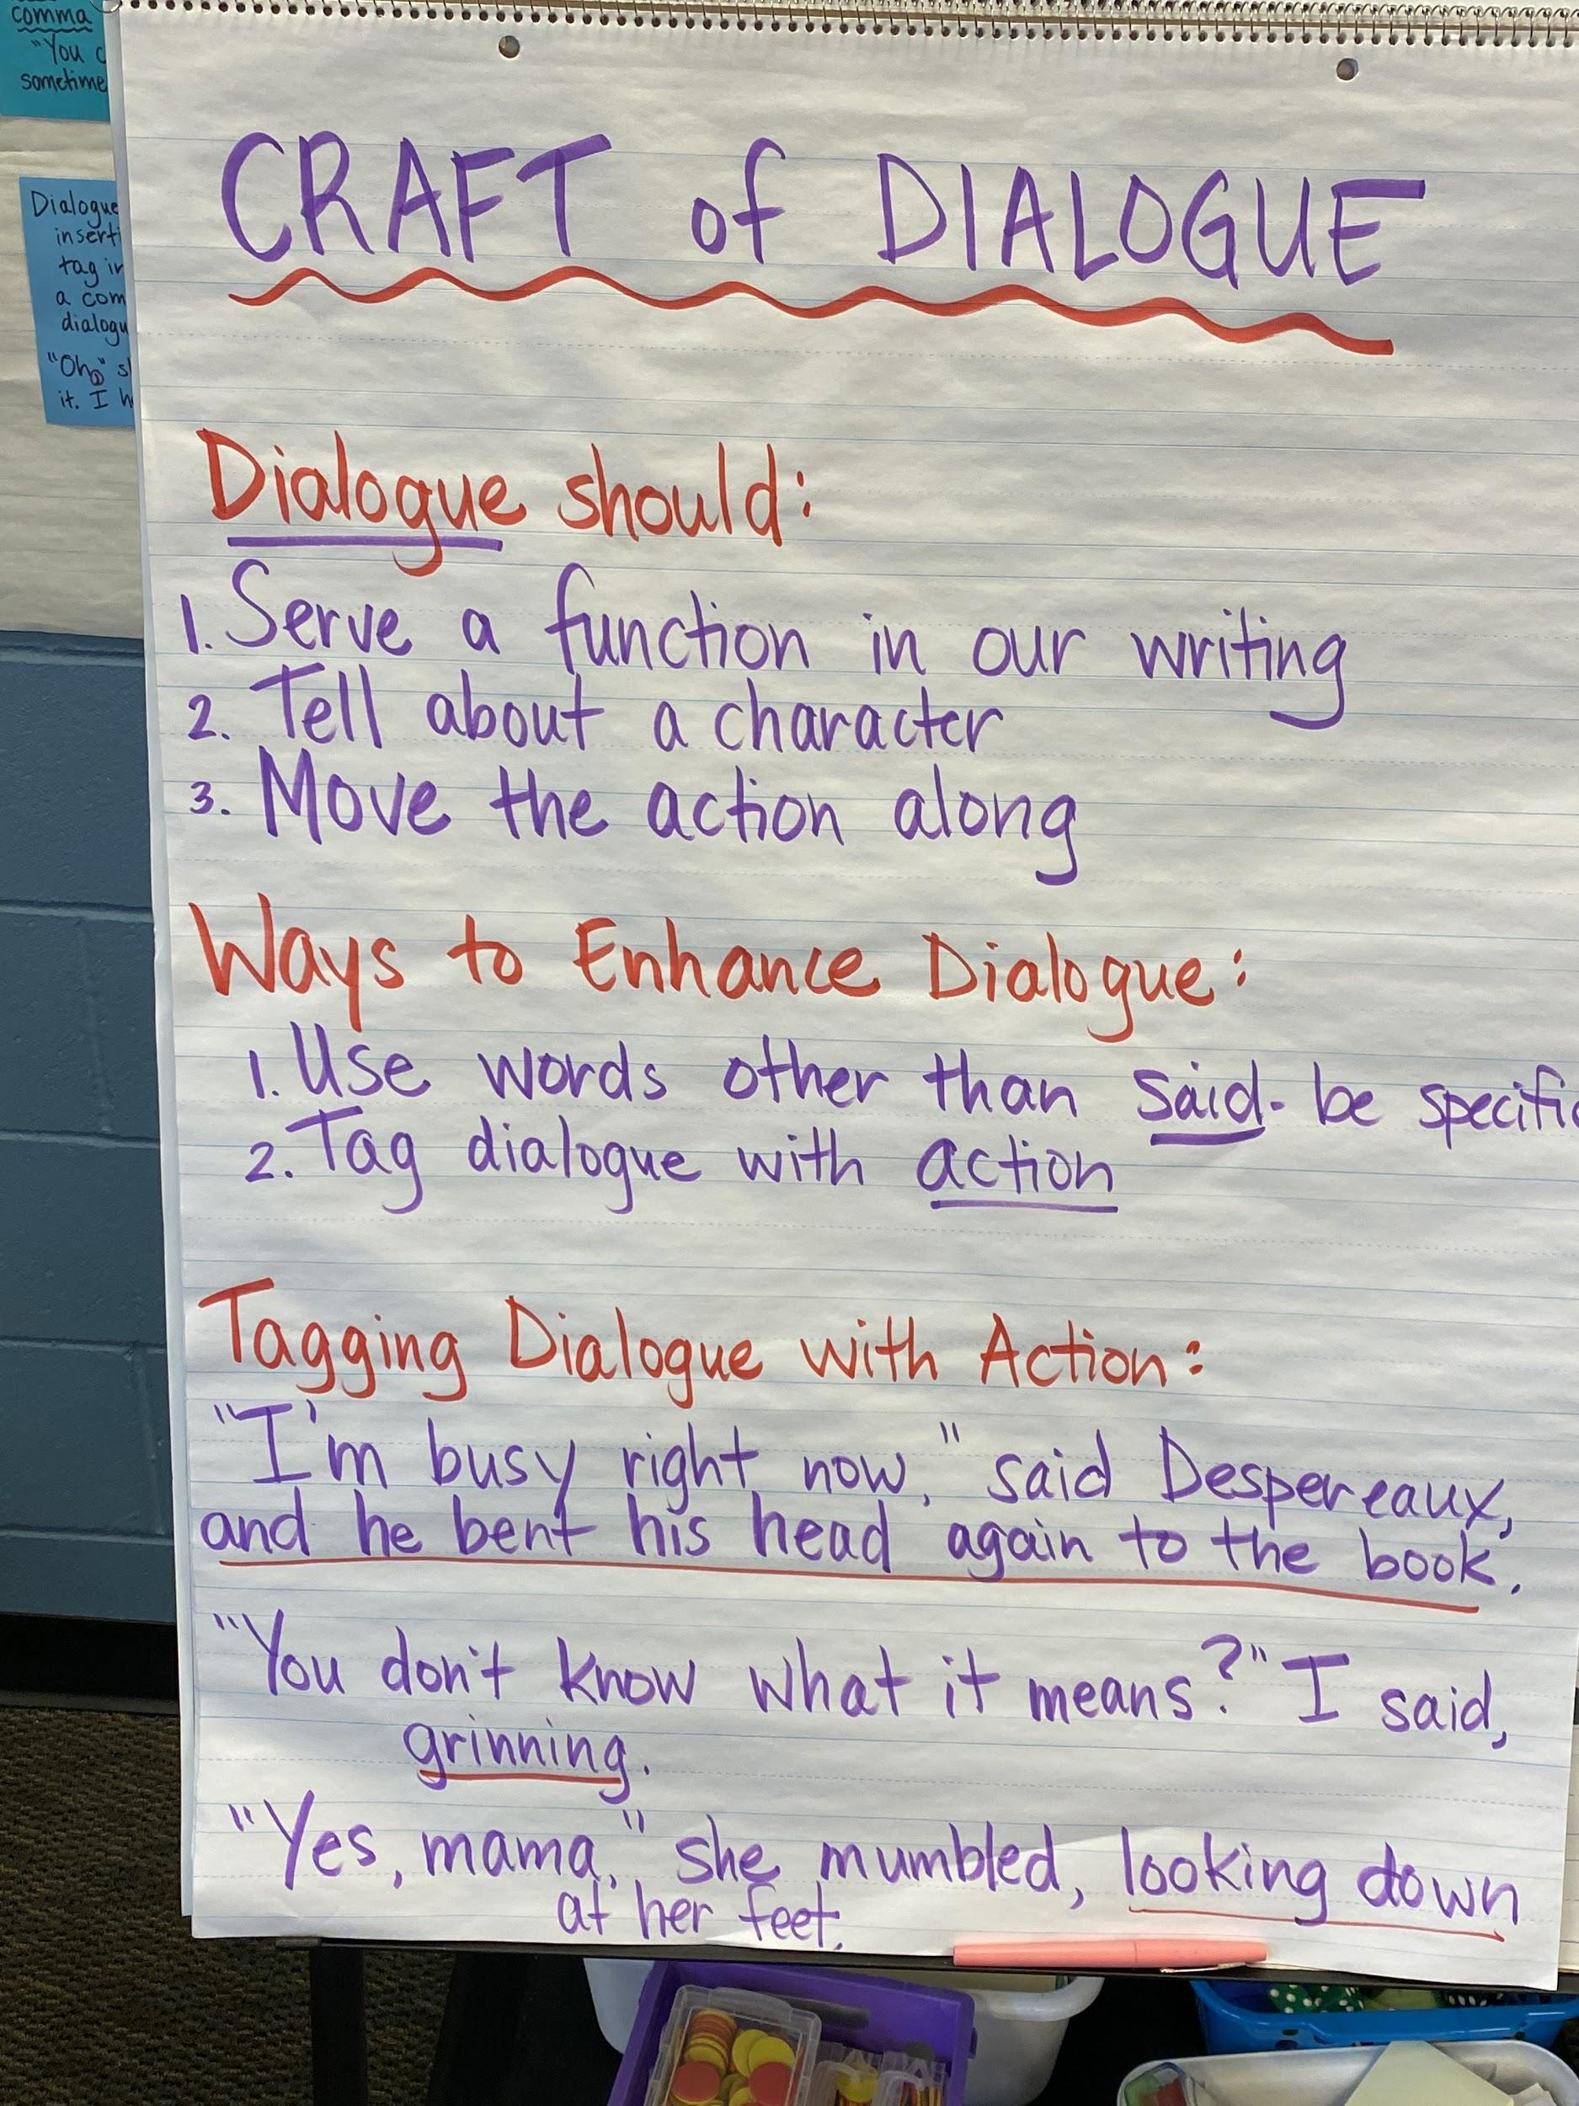
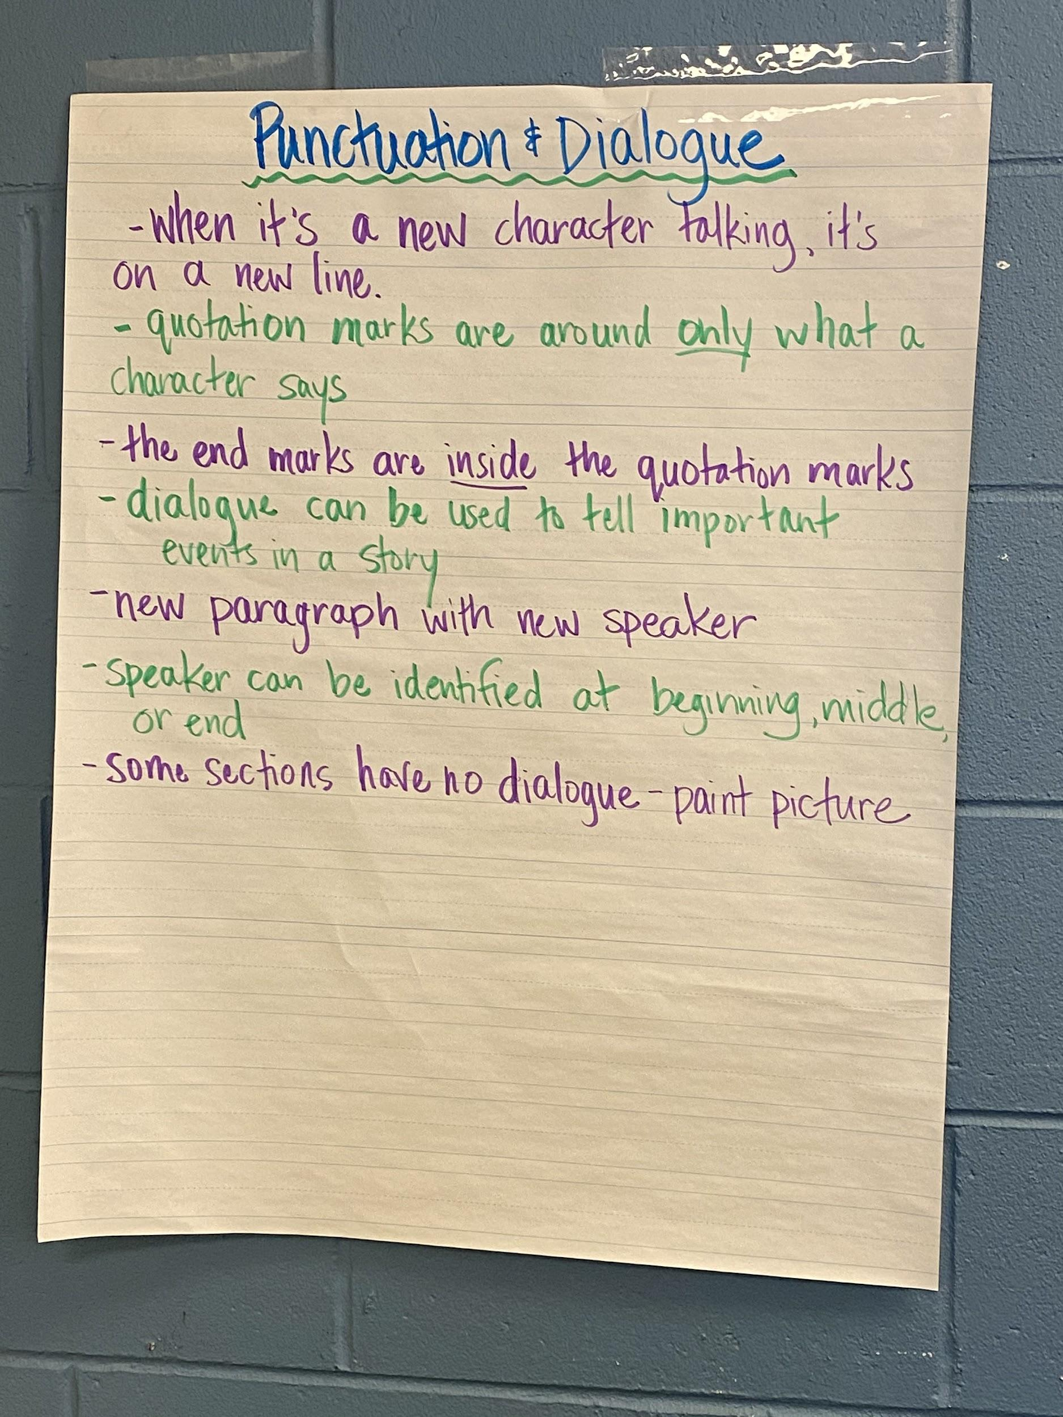
Ideas for your Grade Level
1. Grammar Ideas? Mechanics Ideas? Brainstorm a few!
Remember to check your grade level standards!
2. Explore mentor texts for possibilities!
See the charts for some inspiration!

Slide 14
Resources
Mentor Texts Handout
Professional teaching books - Jeff Anderson, Matt Glover
Sample Rubrics (link and handout)
Dialogue Study (4th grade)
Punctuation Study (2nd grade)
Sentence Study (4th grade)
Email - smythb@olmc1.org

Slide 15
References
Anderson, J. (2005). Mechanically inclined: Building grammar, usage and style into writer’s workshop. Portland, ME: Stenhouse Publishers.
Braddock, R., Lloyd-Jones, R., & Schoer, L. (1963). Research in written composition. Champaign, IL: National Council of Teachers of English.
Buckner, A. (2005). Notebook Know-How: Strategies for the Writer’s Notebook. Portland, ME: Stenhouse Publishers.
Calkins, L. M. (1994). The art of teaching writing. Portsmouth, NH: Heinemann.
Fletcher, R. & Portalupi, J. (2001). Writing workshop: The essential guide. Portsmouth, NH, Heinemann.
Glover, M. (2019). Craft and Process Studies: Units that Provide Writers with Choice of Genre. Portsmouth, NH: Heinemann.

